Slide 1

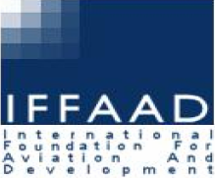
Solidifying the Rule of Law in the Final Frontier:
A Manual
on International Law Applicable to
Military Activities in Outer Space
Symposium on Global Space Issues and Indian Perspective
Session 2: Weaponisation and Conflicts in Space
2 March 2016
New Delhi
David Kuan-Wei Chen
Institute of Air and Space Law
Centre for Research in Air and Space Law
McGill University

Slide 2
Outline
“A day without space”
A coming conflict in the final frontier?
The state of the law
International efforts to fill the gap
Need for MILAMOS
Examples of international manuals
The success of a manual
MILAMOS Process

Slide 3

https://adaywithoutspace.wordpress.com/
“The outer space environment, and the immense resources it provides, is a critical component of human endeavour in the twenty-first century. From communications to financial operations, farming to weather forecasting and environmental monitoring to navigation, surveillance and treaty monitoring, outer space resources play a key role in the activities of all nations. Outer space activities play a significant role in social, economic, scientific and technological development, as well as in the field of international peace and security.”
UN Report Transparency and Confidence-Building Measures in Outer Space Activities (2013)
A variety of civilian commercial, social and economic uses and benefits
Roots of all space applications in the military
Heavy reliance of the military on space applications and objects:
• Intelligence, surveillance, reconnaissance
• Satellite communications
• Global Navigation Satellite Systems (GNSS)
• Space Situational Awareness (SSA)
• Protection of space assets
Notes:
Meteology , telecommunications, phone signals, ATMs , GPS signals, search and rescue operations, access to remote areas; crop monitoring, disaster relief
Intelligence, surveillance, reconnaissance
missile warning, missile defence;
Military use to collect intelligence, national verification means; remote sensing of terrain and objects
targeting, support ground/aerial movements, weather forecasting
• Satellite communications
-relay communications
• Global Navigation Satellite Systems (GNSS)
- air traffic, command and control of armed forces; targeting and tracking;
• Space Situational Awareness (SSA)
- vital info on movement of satellites and space objects; ensure safe operation in space in launch, orbiting (and re-entry)
• Protection of space assets

Slide 4
A coming conflict in the final frontier?
Commentary: US Needs To Prepare for Space War
Defense News, 23 Feb 2016
“The United States therefore needs to face facts and develop the strategy and capabilities to fight and prevail in a war that reaches into space.
The basic reason why is that potential US adversaries — and particularly formidable nuclear-armed ones like Russia and China — are gearing up to take any war with the United States into space”
War in Space May Be Closer Than Ever
Scientific American, 10 Aug 2015
“…as China and Russia aggressively seek to challenge U.S. superiority in space with ambitious military space programs of their own, the power struggle risks sparking a conflict that could cripple the entire planet’s space-based infrastructure. And though it might begin in space, such a conflict could easily ignite full-blown war on Earth.”
“competition between military forces” in space is “a historical inevitability.
PLA Air Force chief Xu Qiliang
“Space is critical to everything that we do in the military. Every mission that we do in the military, doesn’t matter where it is, is critically dependent on space. There is no soldier, sailor, airman, Marine, anywhere in the world that is not critically depending on what we provide in space.”
Gen. John Hyten, US Air Force Space Command
Space is "increasingly congested, contested, and competitive“
US Department of Defense National Security Space Strategy

Slide 5
The state of the law today
There is no treaty law on warfare in outer space
Outer Space Treaty 1967:
Article III
States Parties to the Treaty shall carry on activities in the exploration and use of outer space, …, in accordance with international law, including the Charter of the United Nations, in the interest of maintaining international peace and security and promoting international co-operation and understanding.
Article IV
States Parties …undertake not to place in orbit around the earth any objects carrying nuclear weapons or any other kinds of weapons of mass destruction, install such weapons on celestial bodies, or station such weapons in outer space in any other manner.
The moon and other celestial bodies shall be used by all States Parties to the Treaty exclusively for peaceful purposes.

Slide 6
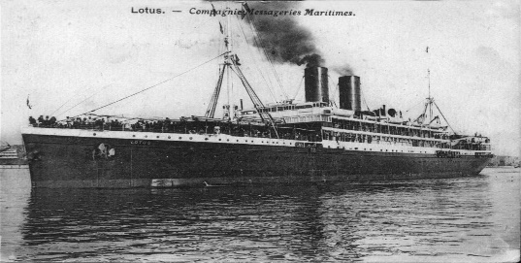
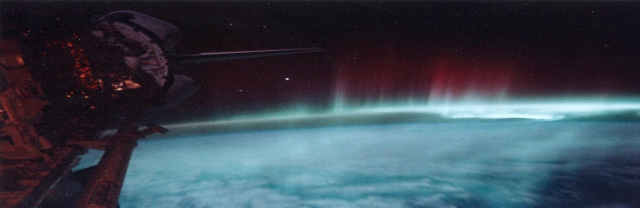
The state of the law today
No reference in international humanitarian law (law of armed conflict) to outer space
No specific treaty on use of new military technologies and means in outer space
“legal lacunae”
International Court of Justice
in Legality of Nuclear Weapons
international humanitarian law applies to “any use of force, regardless of the weapons employed”; applies to ”[weapons] of the past, …of the present and ... of the future”
Permanent Court of International Justice in Lotus
“rules of law … emanate from [States’] own free will … Restrictions upon the independence of States cannot therefore be presumed” “
VS

Slide 7
International efforts to fill the gap
UN General Assembly (UNGA) resolutions
Prevention of an arms race in outer space (1980s to date)
“all States, in particular those with major space capabilities, [should] contribute actively to the objective of the peaceful use of outer space and of the prevention of an arms race in outer space and to refrain from actions contrary to that objective”
Transparency and confidence building measures in outer space activities (2014)
    First meeting in 2015: Disarmament and International Security Committee (First Committee) and the Special Political and Decolonization Committee (Fourth Committee)
No first placement of weapons in outer space (2014) recognised the need to “consolidate and reinforce" the legal regime to maintain the peaceful use of outer space and ensure space activities are consistent with international law

Slide 8
International efforts to fill the gap
Conference on Disarmament (CD)
Draft Treaty on the Prevention of Placement of Weapons in Outer Space (PPWT) proposed by China and Russia in 2008 AND 2014
“while the existing international agreements related to outer space and the legal regime thereof play a positive role in regulating outer space activities, however they are unable to fully prevent the placement of weapons in outer space.”
States undertake NOT to
(a) place any weapons in outer space,
(b) resort to the threat or use of force against outer space objects of States Parties,
(c) engage in outer space activities inconsistent with the subject matter and the purpose of this Treaty, and
(d) assist or incite other States, intergovernmental organisations or nongovernmental entities to participate in activities inconsistent with the subject matter and the purpose of the Treaty
“fundamentally flawed”
US response to the Draft Treaty
Notes:
opposed to any “concepts, proposals and legal regimes” which restrict right to conduct military operations in space

Slide 9
International efforts to fill the gap
International Code of Conduct for Outer Space Activities (later version 2014)
“ voluntary ‘rules of the road’, grounded in best practices among space actors, offer a pragmatic approach to achieving, and strengthening, adherence to norms of behaviour in space”
All States should take:
“measures to prevent space from becoming an area of conflict”
"refrain from the threat or use of force against the territorial integrity or political independence of any state, or in any manner inconsistent with the purposes of the Charter of the United Nations”

Slide 10
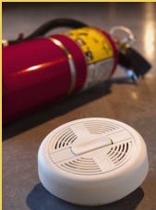
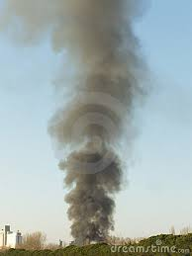
Need for an Manual on International Law Applicable to Military Activities in Outer Space
(MILAMOS)
“It may be said that independently of the international laws existing on this subject, there are to-day certain principles of justice which guide the public conscience, which are manifested even by general customs, but which it would be well to fix and make obligatory….”
Gustave Moynier, The Laws of War on Land, 1880.
Even before the smoke (and fire), we should be prepared for its outbreak…
One-sided interpretations of the law and freedom of action in space is dangerous
Certainty of having some law is better than lawlessness

Slide 11
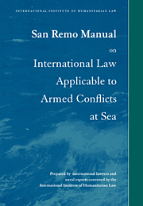
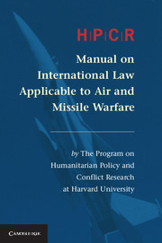
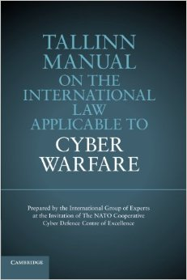
What is a manual ?
A collectively agreed text produced by international group of experts
Experts who acting in personal capacities
List of black-letter rules with commentaries
Based on lex lata (the law as it is) reflected in customary international law
Brings together applicable law on a particular topic
Manual on the International Law Applicable to
Military Activities in Outer Space
Prepared by
McGill University,
University of Adelaide,
….

Slide 12
Examples of international manuals
The Law of War on Land by the Institute of International Law, 1880 (Oxford Manual)
The Hague Draft Rules of Aerial Warfare by the Commission of Jurists, 1923 (Hague Rules)
Manual on International law applicable to Armed Conflict at Sea by the International Institute of Humanitarian Law, 1994 (San Remo Manual)
Customary International Humanitarian Law, by the International Committee of the Red Cross, 2005
Manual on Air and Missile Warfare by the Harvard Program on Humanitarian Policy and Conflict Research, 2013 (Harvard Manual)
Manual on the International Law Applicable to Cyber Warfare by the NATO Cooperative Cyber Defence Centre of Excellence, 2013 (Tallinn Manual)

Slide 13

Stated purpose of manuals
The Law of War on Land 1880
Institute of International Law
“does not propose an international treaty, which might perhaps be premature or at least very difficult to obtain”
“a ' Manual ' [is] suitable as the basis for national legislation in each State….”
“stating clearly and codifying the accepted ideas of our age so far as this has appeared allowable and practicable”.
“A positive set of rules, … [prevents] the unchaining of passion and savage instincts …[strengthens] the discipline … by keeping them within the limits of respect due to the rights of humanity.”

Slide 14
Stated objectives of manuals
Tallinn Manual 2013
NATO Cooperative Cyber Defence Centre of Excellence
“bring together scholars to examine how extant legal norms apply to new form of warfare”
“carefully selected […] legal practitioners, academics and technical experts [is] crucial to the credibility of the final product”

Slide 15

Authority of a manual
Statute of the ICJ, art 38(1):
“The Court, … shall apply:
a. international conventions, whether general or particular, establishing rules expressly recognized by the contesting states;
b. international custom, as evidence of a general practice accepted as law;
c. the general principles of law recognized by civilized nations;
d. subject to the provisions of Article 59, judicial decisions and the teachings of the most highly qualified publicists of the various nations, as subsidiary means for the determination of rules of law.

Slide 16
The success of a manual
A statement of the law as it is (lex lata)
Identify rules that are customary
(but note States may be parties to specific treaties…)
Identify where gaps in law exist
Rules should reflect and be supported by State practice
Benefit from discussions with and input from States
Provide neutral, objective and accurate statement of the applicable law
Precise enough to avoid ambiguity,
open enough to remain relevant

Slide 17
Examples of issues that need clarification
Technical issues:
    What is a space weapon?
Legal issues:
Prohibition on the use of force / self-defence (jus ad bellum)
  Under what circumstances can force be legitimately used?
  What is “armed attack”?
Law of armed conflict (LOAC, jus in bello):
Article 48: Principle of Distinction
  What is civilian and military?
Article 52 (2): Military objective
  Attacks limited to military objects: nature, purpose, use or location
  Article 54: “indispensable to survival of civilian population”
-

Slide 18
Examples of issues
that need clarification
Legal issues:
Application of general international law in times of armed conflict
Application of international environmental law in armed conflict
International criminal law
State responsibility for activities in outer space
Sovereignty, special protections (astronauts), ….etc.

Slide 19
MILAMOS Process
Cooperation between McGill University Centre for Research in Air and Space Law and University of Adelaide Research Unit on Military Law and Ethics… and others?
Expected project timeline of 3 years
First Roundtable of Experts held in September 2015; Plenary of Experts in Autumn 2016
In search of renowned academics, lawyers, technical experts, military practitioners, government officials and relevant observers, such as the International Committee of the Red Cross (ICRC).
Institutional support, particularly from non-Western world, BRICS countries

Slide 20
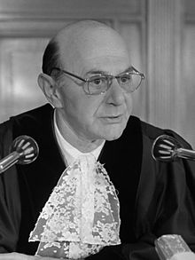
Conclusion
“ …is it not true that we face here fascinating issues of law, a new world or worlds far beyond anything man has ever reached for?”
Manfred Lachs, The International Law of Outer Space (1964)
“A day without space”
A coming conflict in the final frontier?
The state of the law
International efforts to fill the gap
Need for MILAMOS
Examples of international manuals
The success of a manual
“…some of the principles and definitions inherited from the past have become too narrow, highly inadequate and thus require reformulation, or even […] replacement by new ones adapted to new conditions”

